Slide 1
Regional Tertiary Provision Pathfinders – National Advisory Board
4th October 2022

Slide 2
- Scottish Funding Council Review, 2021
“We propose we lead a small number of Tertiary Provision Pathfinders, where we can build on the strong foundations of existing partnerships, to secure more coherent provision that meets the needs of learners, employers, regional and national needs.
The pathfinders will explore what further needs to be done in very practical ways to make the education and skills system responsive, integrated and to support economic recovery and inclusive growth in each region”

Slide 3
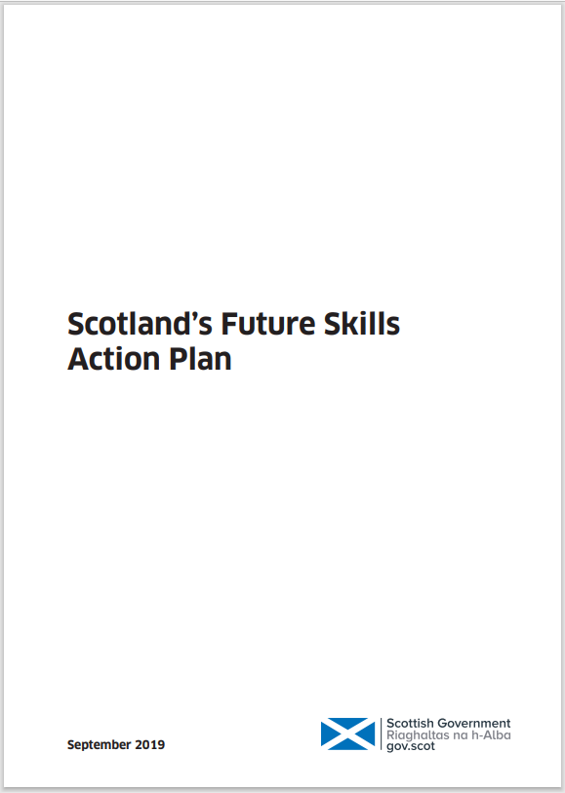
Building on national policy direction…
2018
2019
2022

Slide 4
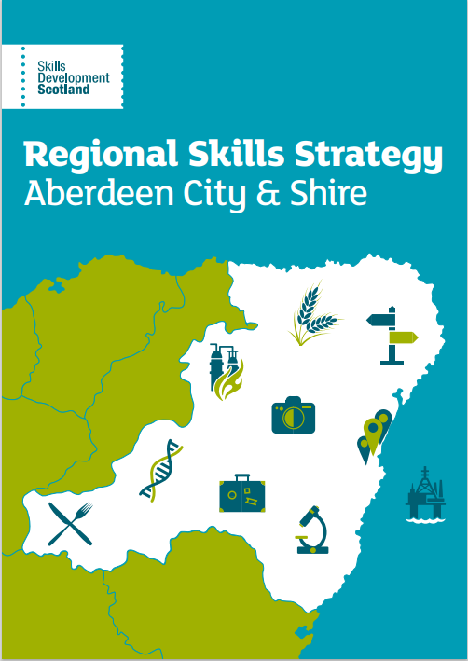
…connecting to regional priorities
Regional skills commitments
Regional Economic Strategies
City Region and Growth Deals
Notes:
NB – NE Regional Economic Strategy being refreshed – will seek sight on this to ensure join-up

Slide 5
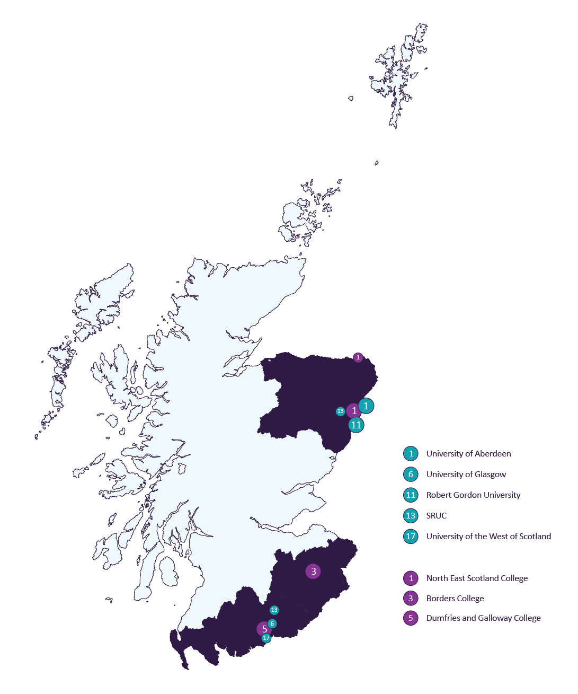
South of Scotland
North-east of Scotland

Slide 6
Vision
‘Through evidence, analysis and collaborative action the pathfinders will explore, in practical ways, what further needs to be done to make the education and skills system responsive, integrated, and supportive of economic recovery and inclusive growth in each region.’

Slide 7
Aims
To assess how colleges and universities in two regional areas plan for coherent provision, and the factors that currently drive provision planning​
To analyse how actual provision is aligned to the needs of prospective students and employers​
To improve learning pathways for people furthest from the labour market and the learner journey from the senior phase of school
To develop expectations and guidance for colleges and universities on better provision planning for skills alignment; to consider how SFC’s funding and accountability mechanisms can best support this

Slide 8
Outcomes
For individual learners and employers
Enhanced collaborative, partnership working in regions resulting in tangible action to address specific skills issues improving outcomes for learners, and better meeting the needs of the economy
For institutions and other key stakeholders
Increased understanding across the sector of good practice and new thinking in skills analysis and alignment
Consensus between institutions and national agencies about how aspects of future provision can best collectively address emerging needs
Enhanced collaborative partnership working across the system
Improved efficiency, enhanced data sharing and use of evidence
For the operating environment
An evidence led, deeper understanding of provision planning within and between institutions informing regional and national policy and practice
Improved efficiency, enhanced data sharing and use of evidence

Slide 9
Impacts
For individual learners and employers
Students are equipped to secure success in their career, meet employer needs and make a positive contribution to society and the economy.
Employers develop sustainable collaborative relationships with academic institutions that better meet industry needs and co-create solutions.
For institutions and key stakeholders
Strengthened strategic planning at regional level where demand signals are picked up quickly by schools, careers services, colleges, universities and students and parents themselves
Development of long-term, strategic business/industry/academic relationships to foster improvements across provision planning and research and knowledge exchange activities.
Institutions actively collaborate each other and partners across and out with the sector to maximise resources, expertise and funding leverage to secure coherent provision and a sustainable future.
For the operating environment
Better guidance on strategic planning for coherent provision across the system, including the use of data sources, collaborative approaches to tertiary education planning, and tracking impacts.
Insight into potential future changes to approaches to funding and approaches to assurance.
A strengthened evidence base for national decision making.

Slide 10
Four linked programme areas
Data and Analysis
Regional Priorities
Process Analysis
Reflections and Recommendations

Slide 11
Data and Analysis
Aim: An understanding of current skills provision, unmet demand, available data and other evidence.
SFC analysts and AAB consultants are conducting analysis on the nature of provision in both regions, and how this changed over time
Skills Development Scotland are contributing analysis on skills demand across both regions
Work is being undertaken to identify any perceived gaps in provision, and the impact of available provision on the learner journey in both regions

Slide 12
Regional Priorities
Aim: Developing approaches to provision planning at a regional level, identifying early areas for action, advancing collaboration, deepening strategic connectedness to employers, piloting new ways of working.
Partners have scoped pilot proposals designed to address key regional skills issues, based on their local expertise and knowledge
Project summaries will be considered by the appropriate Regional Delivery Group with representatives from key regional stakeholders
Institutions have nominated pilot leads, and the Pathfinders Team is working to support project development and to understand learning from new ways of working and emerging challenges

Slide 13
Seven regional pilots
South of Scotland
Developing a joint prospectus for learning and innovation in the land-based sector (SRUC, Borders College and SOSE)
West of Scotland Educational Pathways (Dumfries and Galloway College and University of the West of Scotland)
South of Scotland Digital Skills Hub (Dumfries and Galloway College and Borders College)
North-east
Energy Transition Skills Interactive Pathway - National Energy Skills Accelerator (NESA) (University of Aberdeen, with North-East Scotland College and Robert Gordon University)
Developing demand-led, aligned, and sustainable learner pathways (North-East Scotland College and Robert Gordon University)
Health & Social Care Partnership (Robert Gordon University working with North-East Scotland College, University of Aberdeen and NHS Grampian)
Senior Phase – Curriculum Pathfinder (North-East Scotland College and two Local Authorities)

Slide 14
Process Analysis
Aim: understanding the curriculum review and planning process in colleges and universities, including the influence of employers, and other partners, and the impact on the learner journey
An expert curriculum group has been convened from each sector who will meet regularly and work with SFC to deliver the outputs.
Initial qualitative work is underway focusing on the curriculum review and planning process in our institutions, and what influences their decisions and ability to implement changes
This will include consideration of how SFC supports provision planning and the assurances we need from institutions
This work will inform a report on institutional approaches to provision planning, including case studies and exemplars to include key influences and the impact on learner journey.

Slide 15
Reflections and Recommendations
Aim: producing recommendations and lessons learned from each work package, sharing new thinking for learners, employers, and the wider system in skills planning and alignment.
Activity:
Drawing on lessons learned from each of the work packages
Using the insight of the academics, practitioners and local partners involved in this work to best effect
Taking forward SFC’s statutory duty to secure coherent provision through collaborations in other regions
Considering implications for SFC’s approaches to accountability, assurance and funding

Slide 16
Any questions? Alternatively, you can get in touch with the team at Pathfinders@sfc.ac.uk

